Slide 1

An LLM-Based Multi-Agent Code Generation, Review, and Vulnerability Explanation System with Local LLM Deployment
Supervisor
Presented by
Dr Nithisha J Professor
SIMATS
L Sai Pavan (192472129) G vinay kumar reddy(192472093)

Slide 2
ABSTRACT
Large Language Models (LLMs) have become an important part of modern software development by assisting developers in generating code from natural language prompts. However, AI-generated code may contain logical errors, poor coding practices, or security vulnerabilities. This project proposes an LLM-Based Multi-Agent Code Generation, Review, and Vulnerability Explanation System with Local LLM Deployment. The system uses multiple AI agents to perform code generation, automated code review, vulnerability detection, and explanation of security issues. Deploying the LLM locally ensures data privacy, reduces dependency on cloud services, and enables offline usage. The proposed system improves software quality, enhances security, and increases developer productivity.

Slide 3
INTRODUCTION
Large Language Models (LLMs) have transformed software development by automating code generation and programming assistance.
AI-generated code can improve development speed but may contain logical errors, poor coding practices, or security vulnerabilities.
Manual code review and vulnerability analysis are time-consuming and require significant developer effort.
The proposed system uses a multi-agent architecture, where different AI agents collaborate to generate, review, and secure code.
The system detects common security vulnerabilities and provides clear explanations with recommended fixes.
Local deployment of the LLM ensures data privacy, offline execution, and reduced dependence on cloud services.

Slide 4
OBJECTIVES
The main objectives of this project are:
To generate source code automatically from user requirements.
To review the generated code and identify syntax or logical errors.
To detect common software security vulnerabilities.
To explain detected vulnerabilities in a simple and understandable manner.
To recommend secure coding practices and possible fixes.
To deploy the LLM locally for enhanced privacy and offline accessibility.
To improve software quality and developer productivity.

Slide 5
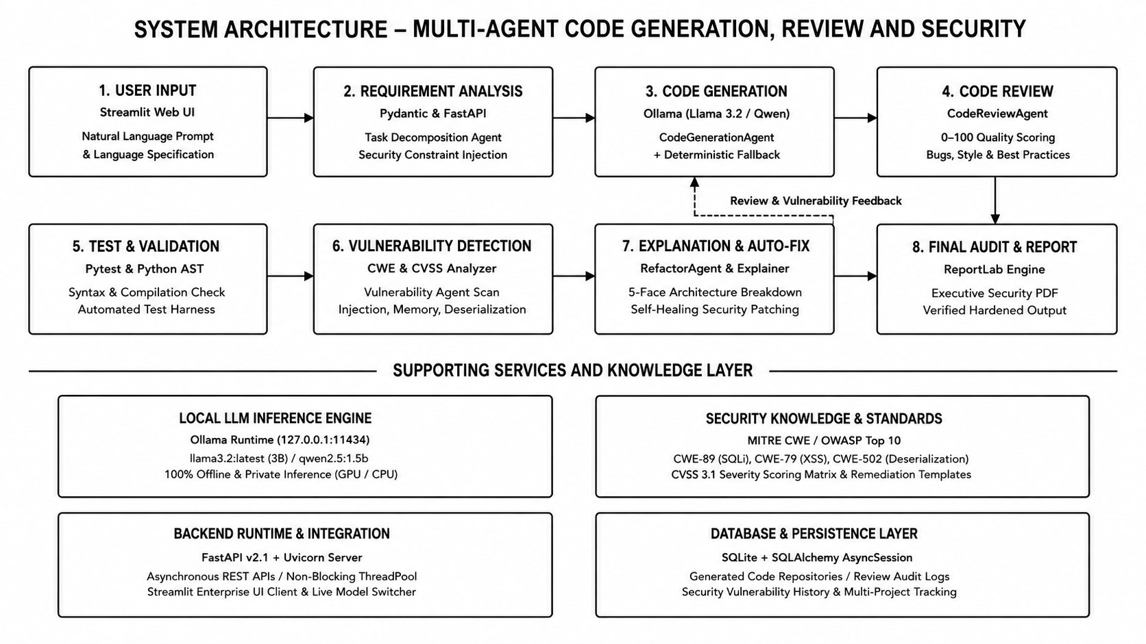

Slide 6
Module 1:Multi-Agent Code Generation and Review
Objective
To automatically generate source code from user requirements and improve its quality through intelligent code review.
Key Points
Accepts user prompts and converts them into executable source code.
Generates code using a locally deployed Large Language Model (LLM).
Reviews the generated code to identify syntax and logical errors.
Suggests improvements for code readability, efficiency, and maintainability.
Ensures adherence to coding standards and best programming practices.
Produces optimized, clean, and high-quality source code for further security analysis.

Slide 7
Module 2:Vulnerability Detection and Explanation
Objective
To detect security vulnerabilities in the reviewed code and provide clear explanations with recommended solutions.
Key Points
1.Offline Security Scanning: Python AST + Ollama detect vulnerabilities locally without cloud data leakage.
2. CWE & OWASP Mapping: Detects SQL Injection, XSS, Command Injection, and Insecure Deserialization.
3. CVSS 3.1 Scoring: Classifies vulnerabilities as Critical, High, Medium, or Low.
4. Threat Explanation: ExplanationAgent identifies root causes, execution flow, and security impact.
5. Auto-Fix & Reporting: RefactorAgent generates secure patches and PDF security audit reports.

Slide 8
Literature Review
Year | Authors | Research Title | Methods / Techniques | Key Contribution
2024 | C. E. Jimenez et al. | SWE-bench: Can Language Models Resolve Real-World GitHub Issues? | Repository-level benchmark, issue resolution, LLM-based software engineering evaluation | Introduced a benchmark containing real-world GitHub issues to evaluate whether language models can understand repositories, modify code, and resolve practical software-engineering problems.
2024 | C. E. Jimenez et al. | SWE-agent: Agent-Computer Interfaces Enable Automated Software Engineering | LLM agent, agent-computer interface, repository navigation, tool use, iterative debugging | Presented an LLM-based software-engineering agent that interacts with repositories and development tools to investigate issues and implement fixes.
2024 | S. Zhang et al. | AutoCodeRover: Autonomous Program Improvement | LLM agent, repository search, code navigation, program repair, iterative reasoning | Proposed an autonomous approach for resolving software issues by combining repository exploration, code search, reasoning, and automated program modification.
2024 | X. Chen et al. | ChatDev: Communicative Agents for Software Development | Role-based multi-agent collaboration, conversational communication, task decomposition | Demonstrated how specialized LLM agents such as programmers, reviewers, and testers can collaborate to automate different stages of software development.
2024 | J. Yang et al. | RepoCoder: Repository-Level Code Completion Through Iterative Retrieval and Generation | Repository retrieval, iterative retrieval-generation, contextual code completion | Showed that retrieving relevant repository context and iteratively generating code can improve code completion for large software repositories.

Slide 9
TOOLS AND TECHNOLOGIES
Programming: Python 3.10+ for code generation, automation, security analysis, and LLM integration.
Development: VS Code / PyCharm for coding, debugging, testing, and project development.
Database & Data Handling: SQLite, SQLAlchemy, Pydantic, Pandas, and JSON for data storage and processing.
AI Technologies: Ollama, Llama 3.2, Qwen 2.5, Prompt Engineering, and Multi-Agent Architecture for code generation, review, and explanation.
Web Development: Streamlit, FastAPI, and Uvicorn for the frontend interface and backend API.
Security & Reporting: MITRE CWE, CVSS 3.1, Bandit, bcrypt, JWT, ReportLab, and Plotly for vulnerability analysis, authentication, visualization, and reporting.

Slide 10
CONCLUSION AND FUTURE SCOPE
Conclusion
Developed an LLM-based multi-agent system for automated code generation, code review, vulnerability detection, and security explanation.
Integrated specialized AI agents to improve code quality, identify logical errors, and detect common software vulnerabilities.
Enabled context-aware vulnerability explanation with secure coding recommendations to assist developers.
Deployed the LLM locally to ensure data privacy, offline execution, and reduced dependence on cloud-based services.
Reduced manual code review effort while improving software security, development efficiency, and overall productivity.
Future Scope
Integrate the system with popular IDEs such as Visual Studio Code and PyCharm for real-time coding assistance.
Support additional programming languages and frameworks for broader application.
Implement automatic vulnerability remediation by generating secure code fixes.
Integrate with CI/CD pipelines for continuous code review and security analysis.

Slide 11
REFERENCES
OpenAI. GPT Models and Large Language Models. https://openai.com
Meta AI. Llama: Open and Efficient Foundation Language Models. https://ai.meta.com/llama
Hugging Face. Transformers Documentation. https://huggingface.co/docs/transformers
LangChain Documentation. https://python.langchain.com
OWASP Foundation. OWASP Top 10 Web Application Security Risks. https://owasp.org/www-project-top-ten
Bandit Documentation. https://bandit.readthedocs.io
Semgrep Documentation. https://semgrep.dev

Slide 12
THANK YOU

